Slide 1


ENTREPRENEURSHIP AND INNOVATION AS CAREER OPPORTUNITY
Rather of looking for work, let us create it.
By
Randrita Sarkar

Slide 2
AT A GLANCE: ENTREPRENEURSHIP
01
AN OVERVIEW OF ENTREPRENEURSHIP
AISAAS
02
THE TREND : AI AS A SERVICE
FINTECH
03
Get a modern PowerPoint Presentation that is beautifully I designed.
04
PROJECT
Agenda

Slide 3
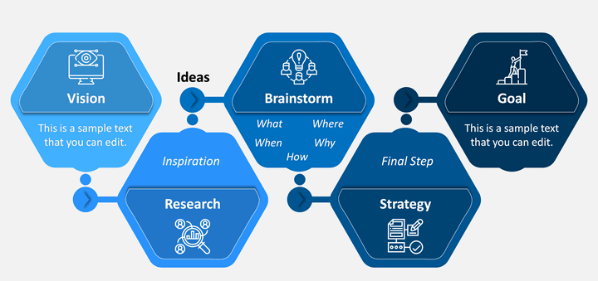
ENTREPRENEURSHIP
MAKING OF AN ENTREPRENEUR

Slide 4
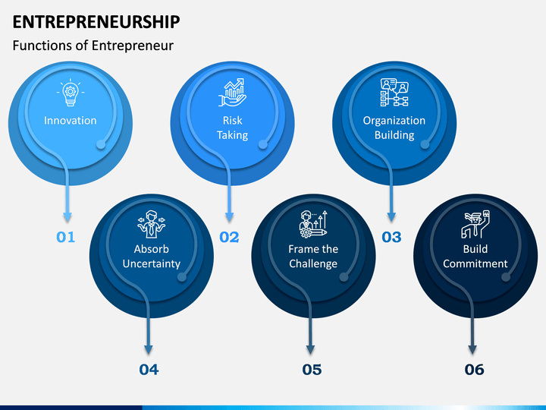
ENTREPRENEURSHIP
FUNCTIONS AN ENTREPRENEUR

Slide 5


Slide 6
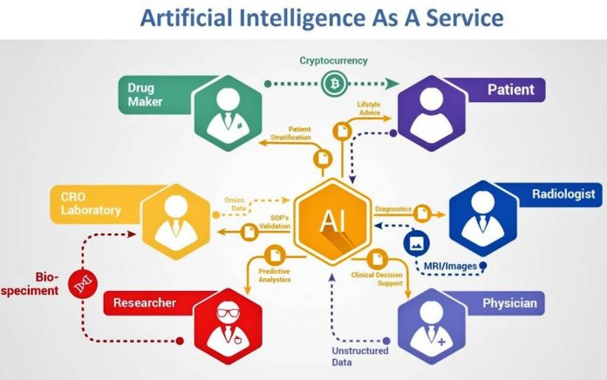
What is AIaaS?
Artificial intelligence as a service refers to off-the-shelf AI tools that enable companies to implement and scale AI techniques at a fraction of the cost of a full, in-house AI.
Why Its Booming?
As cloud services have become incredibly accessible, AI is more accessible: companies can gather and store infinite data. This is where AI-as-a-service comes in.

Slide 7
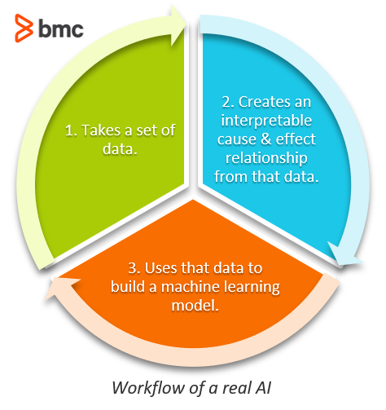
computers can seem to act like a human brain:
Determining objects in a picture
Carrying on a spontaneous conversation with a human being
Responding to roadblocks from a driverless car
Chatting with humans with 24/7 availability
Companies want to take advantage of all the insight they can glean from data. For organizations, data might help them:
Better understand their customers and what they want
Find points in production and service delivery that can be automation
Understand why some people buy and some don’t

Slide 8
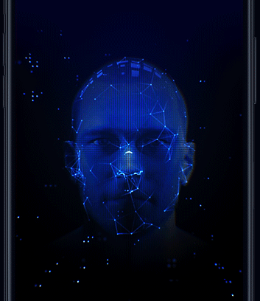
Chatbots & digital assistance
Cognitive computing APIs
Machine learning frameworks
Fully managed machine learning services

Slide 9


Slide 10
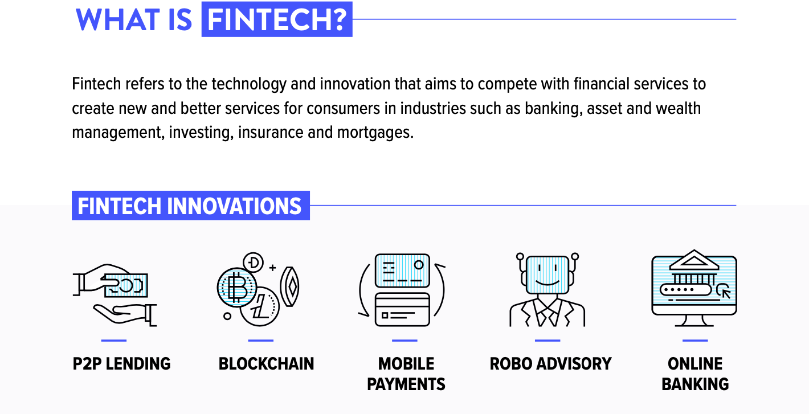

Slide 11
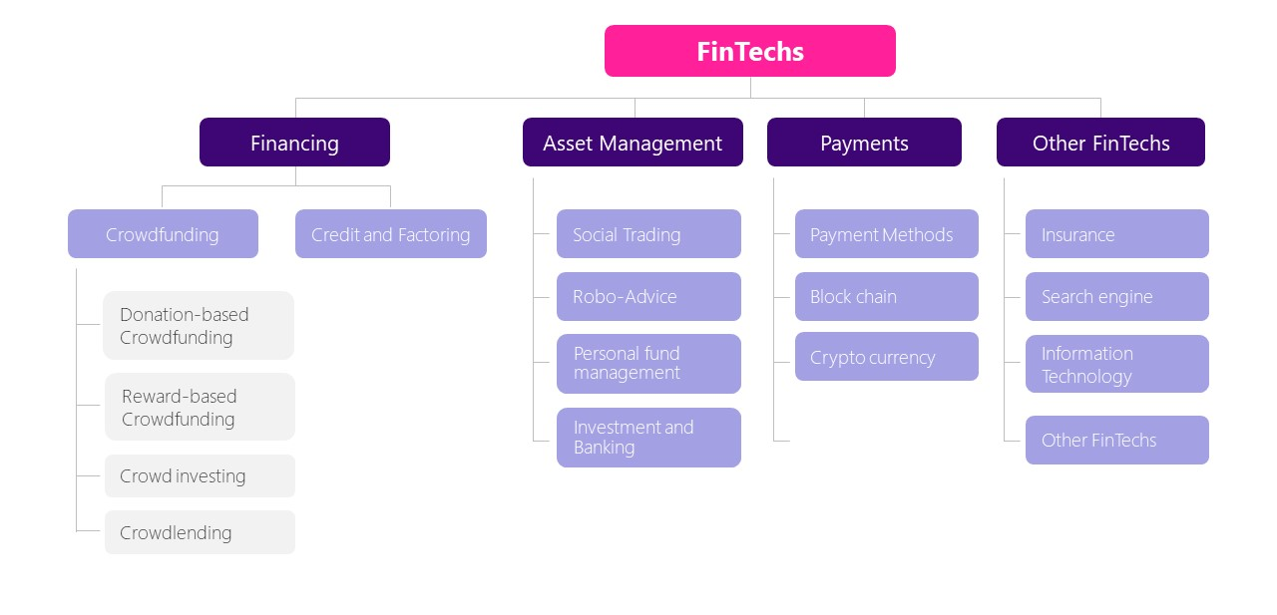

Slide 12



Slide 13
COMMERCIAL ASPECT
01
02
Teaching-Purpose
Complex Calculation
Can Be Made Easy
03
04
Augumented Reality
Gesture Controls

Slide 14
Being Entrepreneur Is Better Than Employment
Innovators
Financial growth
Independence
Personal and career growth

Slide 15
THANK YOU
The Best Way to Predict Future is to create it

